Slide 1
2018

Slide 2
European Day of Languages 2018
European Day of Languages is normally celebrated on 26th September each year. We are celebrating it this week instead.
The general objectives of the European Day of Languages are:
Alerting the public to the importance of language learning and diversifying the range of languages learnt in order to increase intercultural understanding;
Promoting the rich linguistic and cultural diversity of Europe;
Encouraging lifelong language learning in and out of school, whether for study purposes, for professional needs, for purposes of mobility or for pleasure and exchanges.

Slide 3
Round 1:
Guess the language (music)
https://www.youtube.com/watch?v=41rxCqtkQ1U
Open video in Chrome.
You have 15 seconds to listen to each clip and then write your answer.
Answers are given after each song.
Use the box of languages on the right to help you with the answers.

Slide 4
Round 2:
Guess the language (spoken word)
Watch the video & write down which language you think each person is speaking.
Use the same list of languages in the box on the right of your answer sheet to help you.
The answers are on the next slide.

Slide 5
Round 2: Answers
Cantonese
Kerala
Greek
Farsi
Urdu
Arabic
Italian
Spanish
Malayalam
Arabic
Bulgarian
Shona
Greek
Spanish
Gaelic

Slide 6
Round 3:
General Knowledge Quiz on Europe (multiple choice)
Answers given after the 15 questions
(slides 22, 23 &24).

Slide 7
Question 1:
If you were drinking horchata, where would you be?
Italy
Spain
Portugal

Slide 8
Question 2:
Which is Europe’s busiest port?
Rotterdam
Felixstowe
Hamburg

Slide 9
Question 3:
This is the flag of which country?
Norway
Hungary
Greece

Slide 10
Question 4:
When it is midday in Liverpool, what time is it in Portugal?
midday
11am
2pm

Slide 11
Question 5:
What would you do with a frikadeller?
Wear it
Watch it
Eat it

Slide 12
Question 6:
Which of these islands is part of France?
Corsica
Capri
Sardinia

Slide 13
Question 7:
Which country is not part of the Iberian Peninsula?
Italy
Spain
Portugal

Slide 14
Question 8:
Boże Narodzenie (Polish) , Natale (Italian) and Kerstdagen (Dutch) mean?
Birthday
Christmas
Good morning

Slide 15
Question 9:
Which country is famous for apple strudel?
Ireland
France
Austria

Slide 16
Question 10:
Which car company is NOT European?
Kia
Seat
c) Fiat

Slide 17
Question 11:
What shape is the Swiss flag?
Rectangle
Square
Triangle

Slide 18
Question 12:
What does the Italian phrase ‘che ore sono?’ mean?
What is your name?
Who are you?
What time is it?

Slide 19
Question 13:
Spot the non-German composer?
Strauss
Beethoven
J S Bach

Slide 20
Question 14:
Which of the following cheeses is not French?
Manchego
Brie
Camembert

Slide 21
Question 15:
Which group of languages does English belong to?
Romance
Germanic
c) Slavic

Slide 22
Q1: If you were drinking horchata, where would you be?
B) Spain. Horchata is a nut-based drink.
Q2: Which is Europe’s busiest port?
Rotterdam – it is the world’s 9th busiest port
Q3: This is the flag of which country?
Greece
Q4: When it is midday in Liverpool, what time is it in Portugal?
Midday (Portugal and UK are in the same time zone)
Q5: What would you do with a frikadeller?
C) Eat it. It is a type of meatball popular in Denmark & Germany
Q6: Which of these islands is part of France?
A) Corsica – Capri and Sardinia are Italian.

Slide 23
Q7: Which country is not part of the Iberian Peninsula?
B) Italy (Iberia consists of Spain and Portugal)
Q8: Boże Narodzenie, Natale and Kerstdagen all mean…
B) Christmas
Q9: Which country is famous for apple strudel?
Austria
Q10: Which car company is NOT European?
A) Kia (Seat is Spanish and Fiat is Italian)
Q11: What shape is the Swiss flag?
B) Square

Slide 24
Q12: What does the Italian phrase ‘che ore sono?’ mean?
C) What time is it?
Q13: Spot the non-German composer.
A) Strauss. He was Austrian.
Q14: Which of the following cheeses is not French?
B) Manchego (from Northern Spain)
Q15: Which group of languages does English belong to?
B) Germanic

Slide 25
Round 4: Idioms Round
Read the expressions in different languages then work out what the English idiom is.
Choose the correct letter from the list on your answer sheet.
Answers shown on each slide.

Slide 26
English idiom: G. DON’T JUDGE A BOOK BY ITS COVER.
l'abito non fa il monaco (Italian)
Clothes do not make the monk.
quem vê caras não vê corações (Portuguese)
He who sees faces doesn't see hearts.
odijelo ne čini čovjeka (Croatian)
A suit doesn't make a man.
het zijn niet allen koks die lange messen dragen (Dutch)
It's not only cooks that carry long knives.
nu haina il face pe om (Romanian)
Clothes do not make the man.
Q.1

Slide 27
English idiom: E. LIKE FATHER, LIKE SON.
kakov pop takov i prihod (Russian) Like priest like church.
filho de peixe sabe nadar (Portuguese) A fish's child knows how to swim.
de tal palo tal astilla (Spanish)
From such stick comes such splinter.
Aká matka, taka Katka. (Slovak)
Like mother like Kate.
Der Apfel fällt nicht weit vom Stamm (German)
The apple does not fall down far from the tree.
Q.2

Slide 28
English idiom: F. DON’T CRY OVER SPILT MILK.
paid â chodi pais ar ôl piso (Welsh)
Don't lift a petticoat after peeing.
kusat sebe lokti (Russian)
To bite one’s elbows.
eső után köpönyeg (Hungarian)
Coat after rain.
Q.3

Slide 29
English idiom: D. ONCE BITTEN, TWICE SHY.
el gato escaldado del agua fria huye (Spanish) The cat that has been scalded runs away from hot water.
puganaya vorona kusta (telezhnogo skripa/sobstvennoj teni) boitsya (Russian) A spooked crow is afraid of a bush (a carriage squeak/it's own shadow).
cão picado por cobra, tem medo de linguiça (Portuguese) A dog that has been bitten by a snake fears sausages.
cine s-a fript cu ciorba, suflã şi-n iaurt (Romanian) The one who burnt his tongue with the soup is going to blow the yoghurt as well.
Koho raz had uštipne, aj hlísty sa bojí. (Slovak) Who has been bitten by a snake is afraid even of a worm.
Q.4.

Slide 30
English idiom: H. A BAD WORKMAN BLAMES HIS TOOLS.
el mal escribano le echa la culpa a la pluma (Spanish)
The poor writer blames the pen.
el cojo le echa la culpa al empedrado (Spanish)
The limping man blames the pavement.
złej baletnicy przeszkadza rąbek u spódnicy (Polish)
A poor dancer will be disturbed even by the hem of her skirt.
Q.5

Slide 31
English idiom: C. IT’S RAINING CATS AND DOGS.
padají trakaře (Czech)
It's raining wheelbarrows.
det regner skomagerdrenge (Danish)
It's raining shoemakers' apprentices.
brékhei kareklopódara (Greek)
It's raining chair legs.
estan lloviendo hasta maridos (Spanish)
It's even raining husbands.
Q.6

Slide 32
English idiom: I. AS EASY AS FALLING OFF A LOG.
så let som at klø sig i nakken (Danish)
As easy as scratching the back of your neck.
facile come bere un bicchier d'acqua, facile come andare in bicicletta (Italian)
As easy as drinking a glass of water, as easy as cycling.
ežiku ponjatno (Russian)
Understandable to a hedgehog.
tereyagindan kil ceker gibi (Turkish)
As if pulling a strand of hair from butter.
Lahké ako facka (Slovak)
As easy as a slap.
Q.7

Slide 33
English idiom: B. AS THICK AS THIEVES.
aralarindan su sizmaz (Turkish)
Not even water can pass between them.
uni comme les doigts de la main (French)
Tied like the fingers of a hand.
ser como uña y carne (Spanish)
To be fingernail and flesh.
a fi prieteni la cataramã (Romanian)
To be very good friends.
Hustý ako hmla (Slovak)
As thick as a fog.
Q.8

Slide 34
English idiom: J. DON’T COUNT YOUR CHICKENS BEFORE THEY’RE HATCHED.
man skal ikke selge skinnet, før bjørnen er skutt (Danish) One should not sell the fur before the bear has been shot.
na neroden Petko kapa mu skroile (Macedonian) They sewed a hat to Peter who is not born yet.
nu da vrabia din mânã, pe cioara de pe gard (Romanian)
Do not give away the sparrow from your hand for the crow sitting on the fence.
non dire gatto se non ce l'hai nel sacco (Italian)
Never say 'cat' if you have not got it in your sack.
dereyi görmeden paçaları sıvama (Turkish)
Do not roll up your trouser-legs before you see the stream.
Q.9

Slide 35
English idiom: A. TO BE A SANDWICH SHORT OF A PICNIC.
Šplouchá mu na maják (Czech) It's splashing on his lighthouse.
avoir une araigneé au plafond (French) To have a spider on the ceiling.
non avere tutti i venerdì (Italian) To be lacking some Fridays.
tem macaquinhos no sotão (Portuguese) He has little monkeys in the attic.
lud ko struja (Serbian) Crazy as electricity.
ikke at være den skarpeste kniv i skuffen (Danish) Not to be the sharpest knife in the drawer.
Q.10

Slide 36
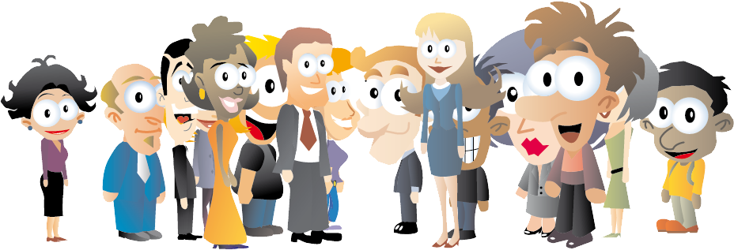
Thank you for participating!
Special thanks to all of the students and staff members who participated in the video.

Slide 37
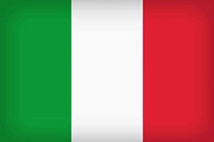
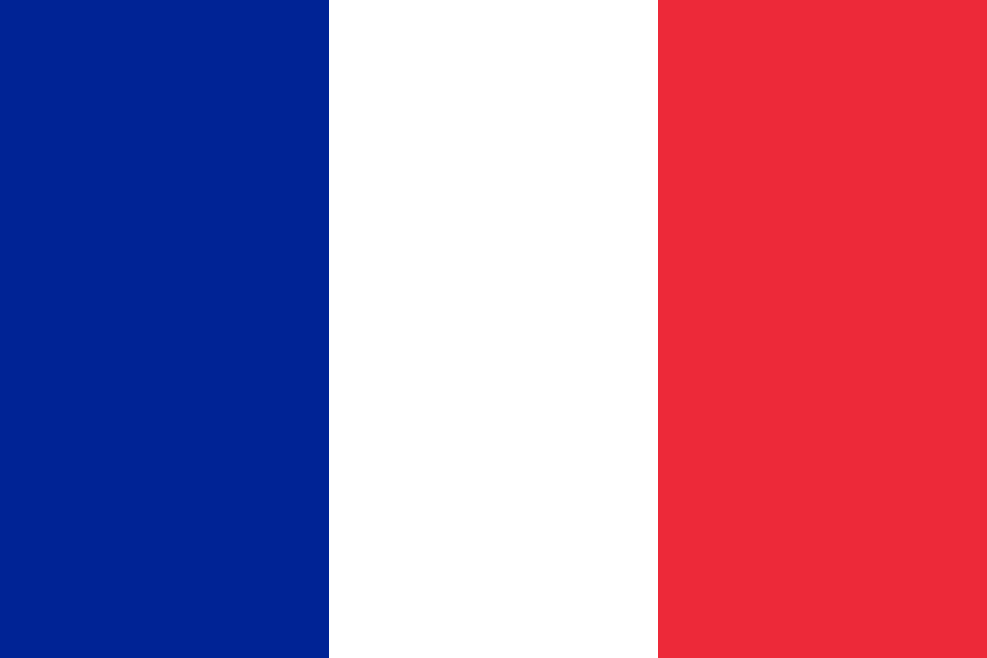
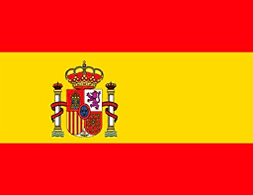
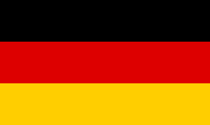
SMA’s European Week of Languages
Monday 29th Oct –Fri 2nd Nov- Teachers wear badges- why?
Tuesday 30th October - Learning for Life Quiz
Wednesday 31st October – European themed Bake Off
Monday 29th Oct – Fri 2nd Nov- European Menu in the canteen

Slide 38
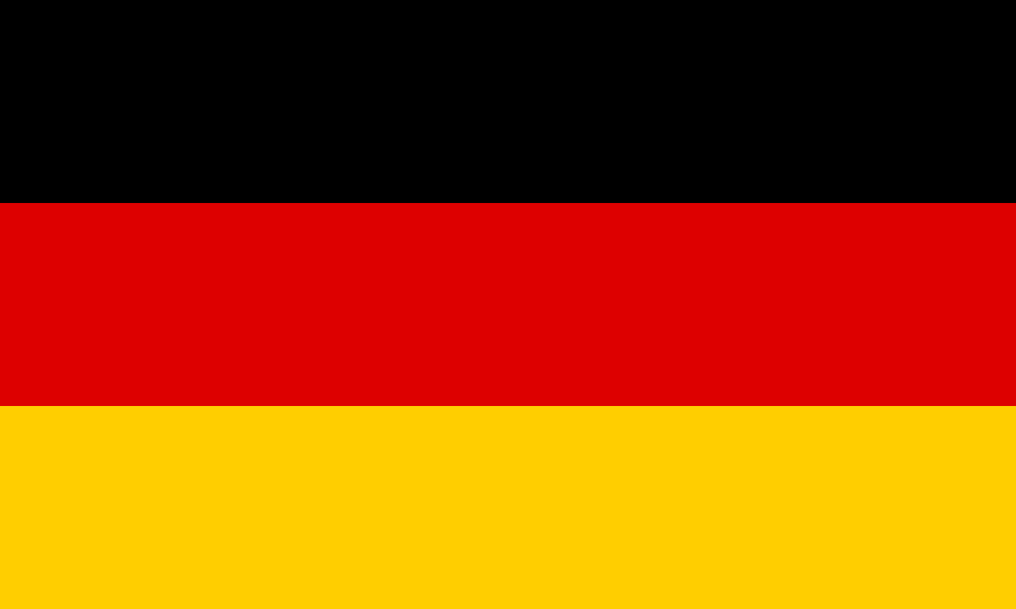
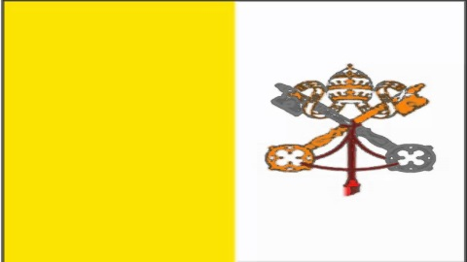
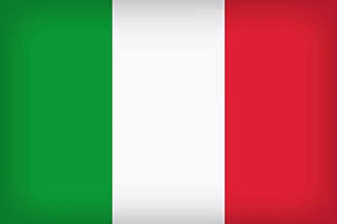
SMA’s European Week of Languages
Monday 29th Oct –Fri 2nd Nov
Teachers are wearing badges representing European countries.
Ask them why they are wearing this particular badge.
Can they teach you any words in this language?
Can they teach you any facts about this country?

Slide 39
SMA’s European Week of Languages
Tuesday 30th October
Learning for Life Quiz on Europe & European Languages

Slide 40
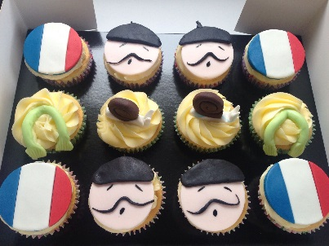
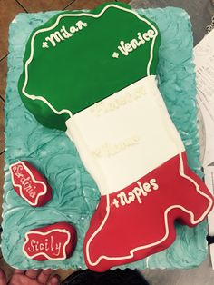
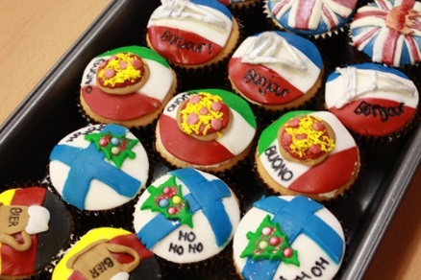
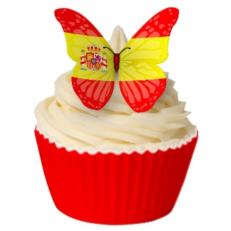
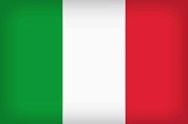
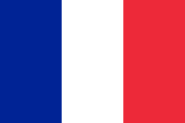
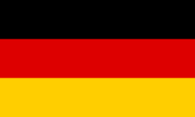
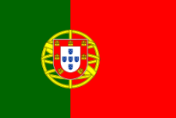
SMA’s European Week of Languages
Wednesday 31st October
European themed Bake Off
Bring in your cakes representing a European country. Prize for best cake. Merits for taking part.
Cakes will be sold at lunch time.

Slide 41
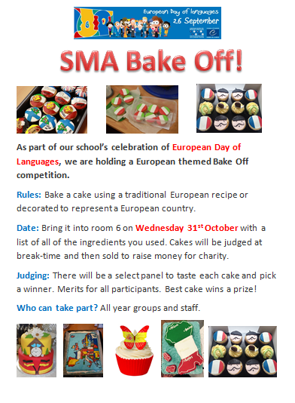

Slide 42
See Miss Monaghan for details.

Slide 43
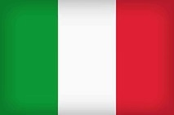
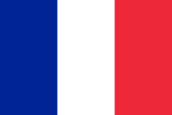
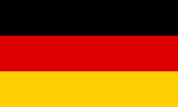
SMA’s European Week of Languages
Monday 29th Oct – Fri 2nd Nov
European Menu in the canteen
Monday: Portugal
Tuesday: Spain
Wednesday: Italy
Thursday: France
Friday: Germany

Slide 44
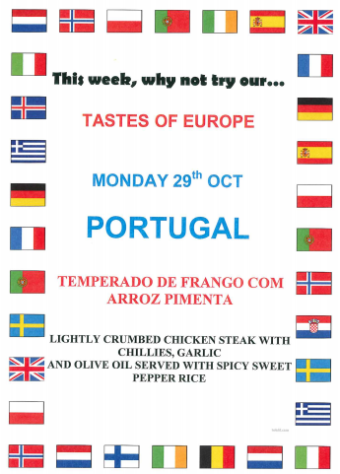
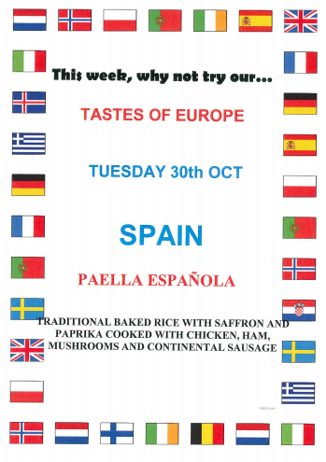

Slide 45
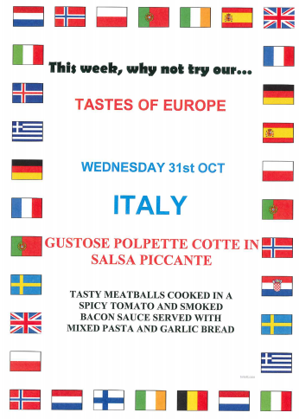
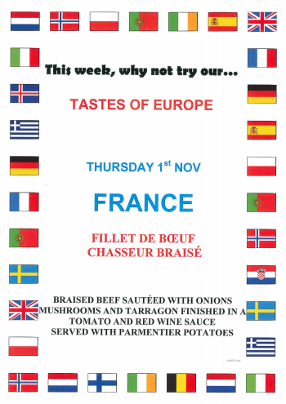

Slide 46
